Slide 1
INSTAGRAM USER ANALYTICS
PROJECT DESCRIPTION:
Imagine you're a data analyst working with the product team at Instagram, Your role involves analyzing user Interactions and engagement with the Instagram app to provide valuable insights that can help the business grow. User analysis involves tracking how users engage with a digital product, such as a software application or a mobile app. The Insights derived from this analysis can be used by various teams within the business. For example, the marketing team might use these insights to launch a new campaign, the product team might use them to decide on new features to build, and the development team might use them to improve the overall user experience

Slide 2
APPROACH:
We have got a dataset which contains many tables that contain information regarding various fields creating log of user activities. We went through the dataset closely and then executed various queries to extract the required data from the table.
TECH/TOOL USED:
We used below mentioned tools to perform the analysis :-
SQL - To run the Query and extract data from database.
PPT – To prepare a detailed report on the observations based on the data received

Slide 3
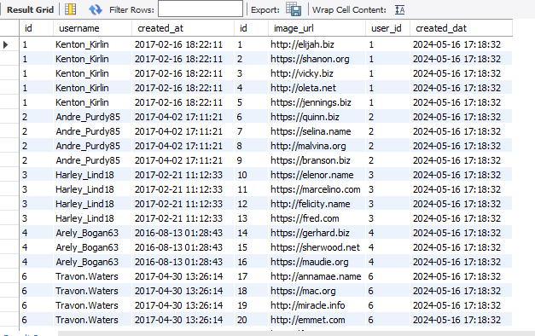
OVERVIEW OF INSTAGRAM USER ANALYTICS DATA SET

Slide 4
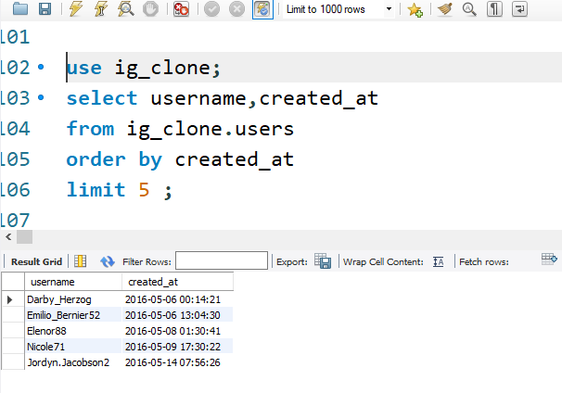
SQL Tasks :
A) Marketing Analysis:
1.Loyal User Reward: The marketing team wants to reward the most loyal users
Your Task: Identify the five oldest users on Instagram from the provided database

Slide 5
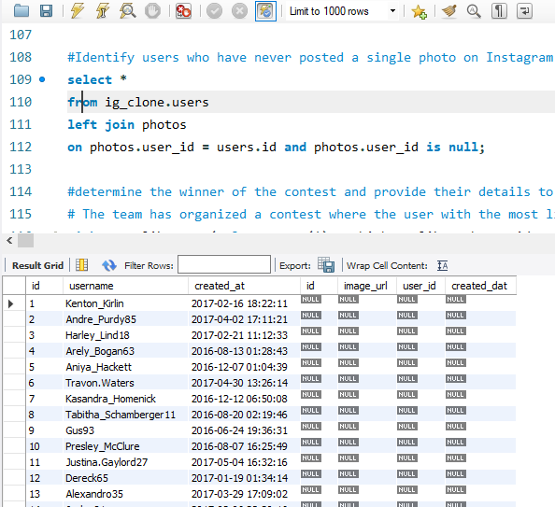
2.Inactive User Engagement:
The team wants to encourage inactive users to start posting by sending them promotional emails Your Task: Identify users who have never posted a single photo on Instagram.

Slide 6
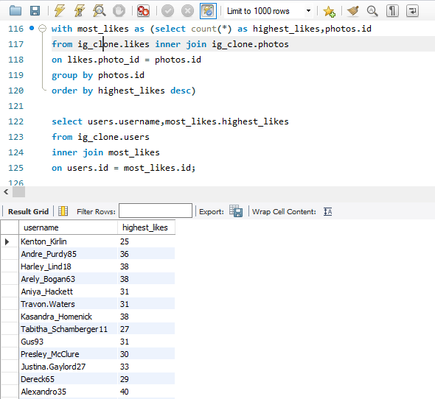
3.Contest Winner Declaration:
The team has organized a contest where the user with the most likes on a single photo wins Your Task: Determine the winner of the contest and provide their details to the team.

Slide 7
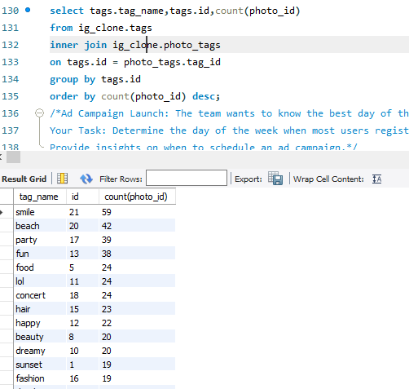
4.Hashtag Research:
A partner brand wants to know the most popular hashtags to use in their posts to
reach the most people. Your Task: Identify and suggest the top five most commonly used hashtags on the platform.

Slide 8
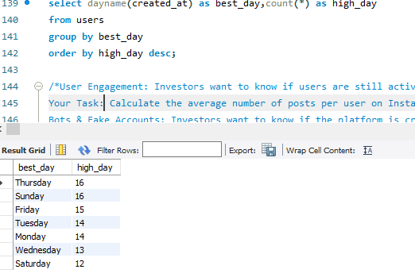
5.Ad Campaign Launch:
The team wants to know the best day of the week to launch ads. Your Task: Determine the day of the week when most users register on Instagram. Provide
insights on when to schedule an ad campaign.

Slide 9
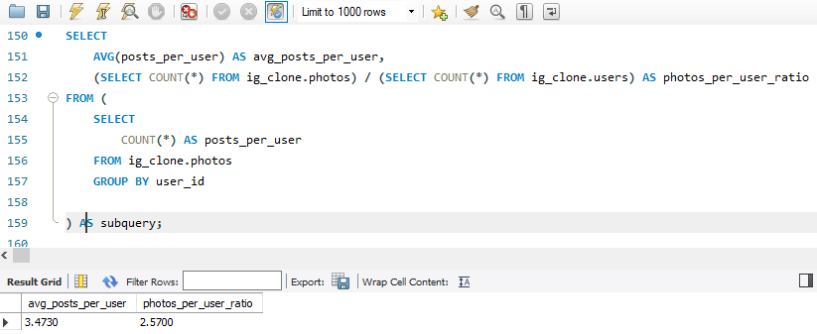
B) Investor Metrics:
1.User Engagement:
Investors want to know if users are still active and posting on Instagram or if they are making fewer posts. Your Task:
Calculate the average number of posts per user on Instagram. Also,
provide the total number of photos on Instagram divided by the total number of users.

Slide 10
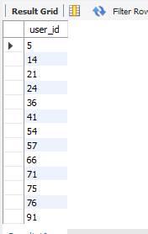
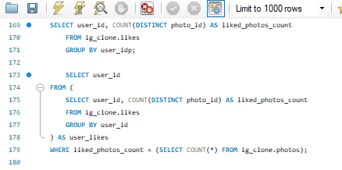
2.Bots & Fake Accounts:
Investors want to know if the platform is crowded with fake and dummy accounts. Your Task:
Identify users (potential bots) who have liked every single photo on the site, as
this is not typically possible for a normal user.

Slide 11
RESULTS :-
The project significantly enhanced my skills in data analysis, software proficiency, and machine learning while deepening my domain expertise. It supported strategic decision-making, operational efficiency, customer insights, and risk management. The analysis provided actionable insights that shaped the organization's strategic direction, fostering a culture of data-driven decision-making and spurring innovation. Personally, the project boosted my confidence, problem-solving abilities, and adaptability, highlighting the transformative power of data. The experience underscored the importance of continuous learning and effectively managing complex data projects, benefiting both the organization and my professional development. The valuable insights gained were instrumental in driving success.

